Slide 1
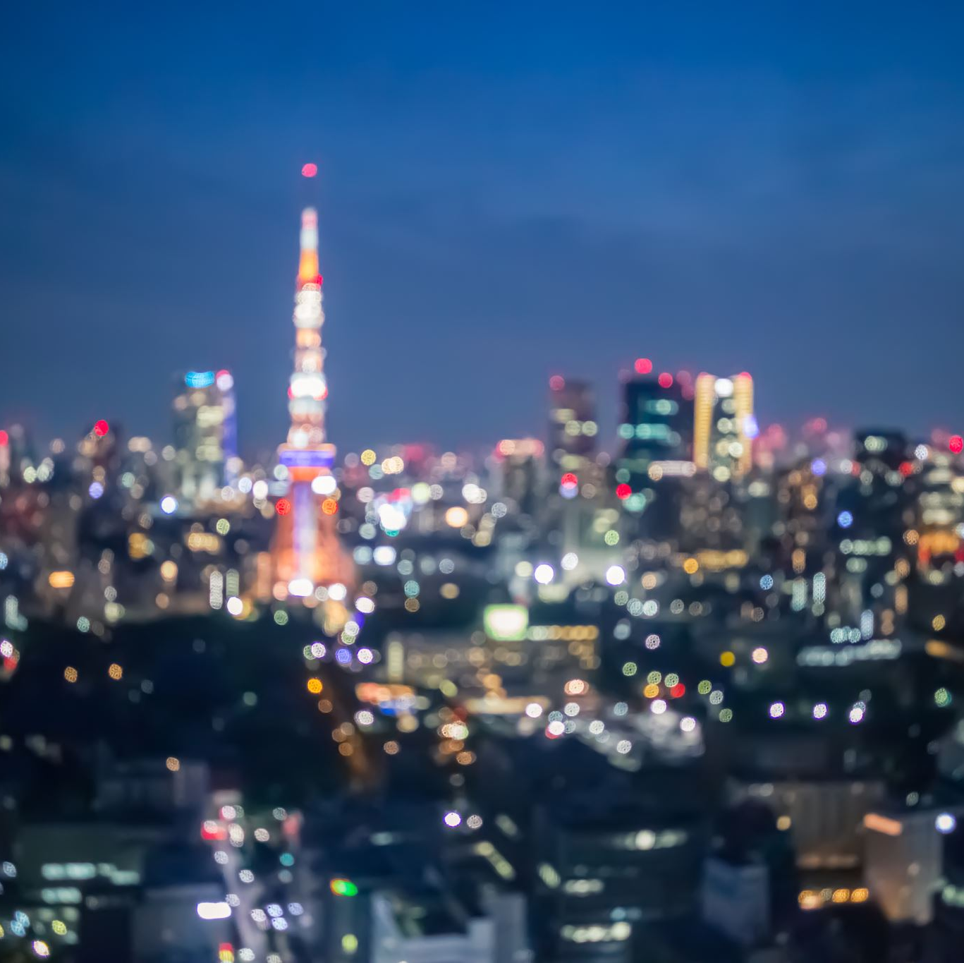
Japan Tourism Data Analytics Project
By Lucas Lim

Slide 2
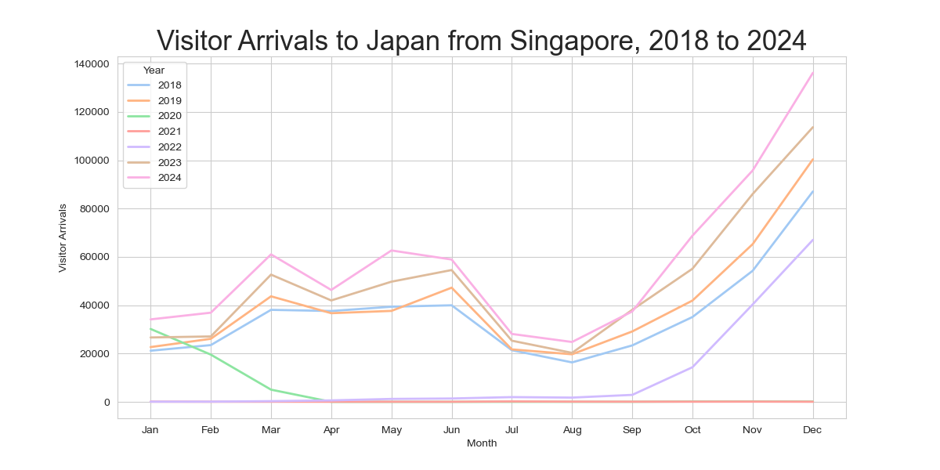
Analysis A1: Singapore Visitor Arrivals to Japan by Month
Singaporean visitor arrivals peaks every December.
December, November, October are the most popular months to Japan for Singapore visitors, while August, July, September, January, February are the popular months.

Slide 3
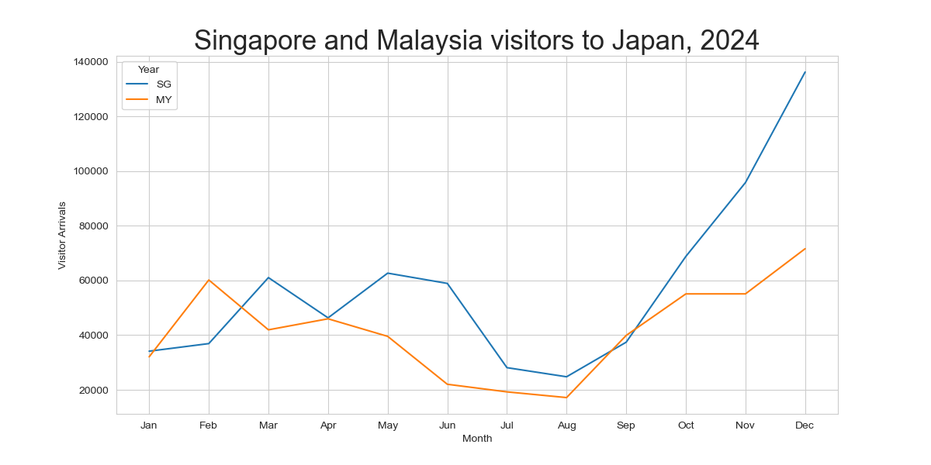
Analysis A2: Visitor Arrivals to Japan - Singapore vs Malaysia
In 2024, Malaysia visitor numbers to Japan exceeded Singapore numbers only in the months of February and September.
Singapore visitor numbers to Japan increase at a faster rate.

Slide 4
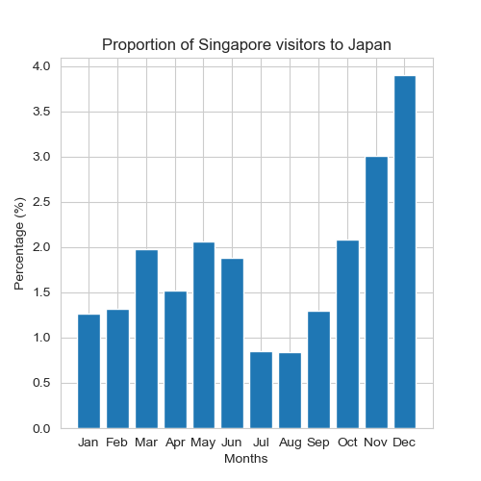
Analysis A3: Singapore Visitor Numbers as a proportion of overall visitor numbers
December has the highest proportion (3.90%) of Singapore visitors to Japan as compared to all foreign visitors to Japan.
July and August (0.84%) sees the least proportion of Singapore visitors to Japan.

Slide 5
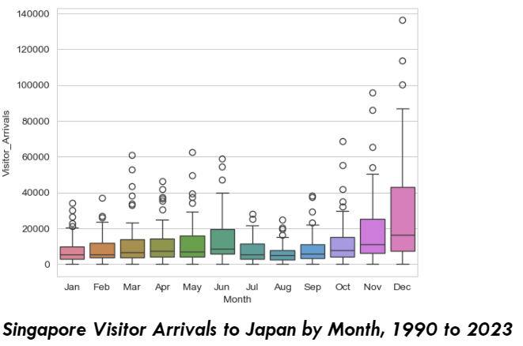
Analysis A4: One-way ANOVA
December has the largest range and largest mean as well
August had the smallest range.
Range starts from zero for all months

Slide 6
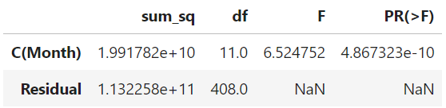
Analysis A4: One-way ANOVA
A one-way ANOVA revealed that there was a statistically significant difference in mean visitor numbers from Singapore between at least eleven groups. F(11,408) = 6.524752, p = <0.05.
We can reject the null hypothesis that there is no difference in visitor arrivals based on Month.

Slide 7
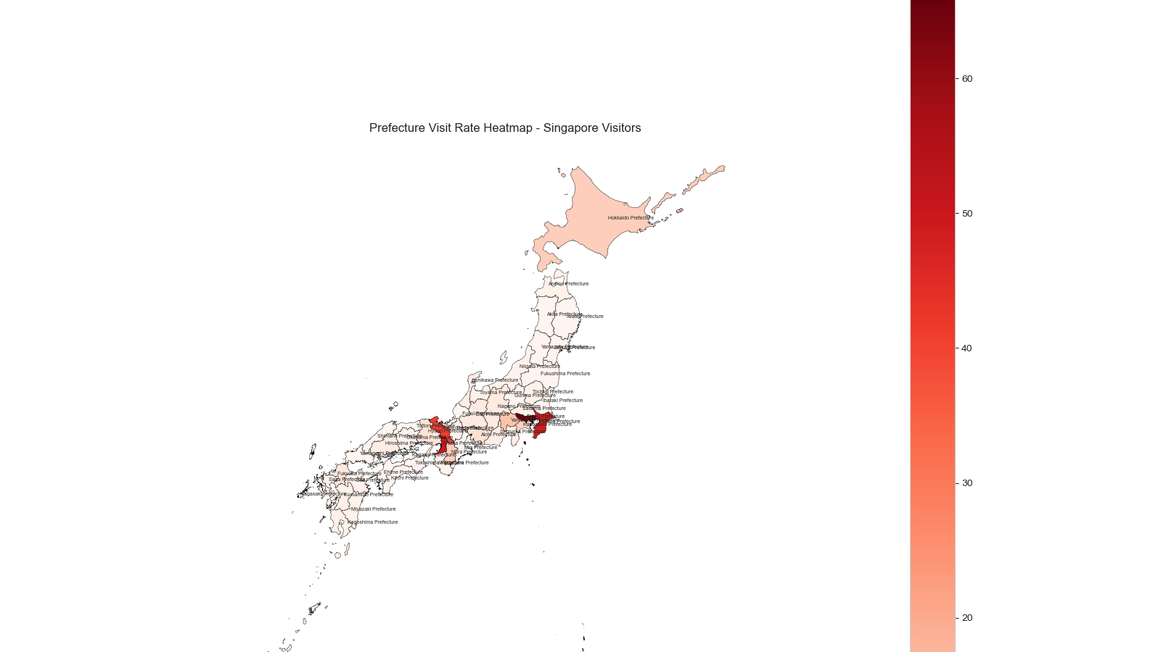
Analysis B1: Prefecture Visit Rate - Singapore (2023)
Most visited prefecture is Tokyo, followed by Chiba, Osaka and Kyoto prefectures.
Nara, Hokkaido, Yamanashi, Kanagawa, Hyogo, Aichi prefectures see a sizable proportion of Singapore tourists.

Slide 8
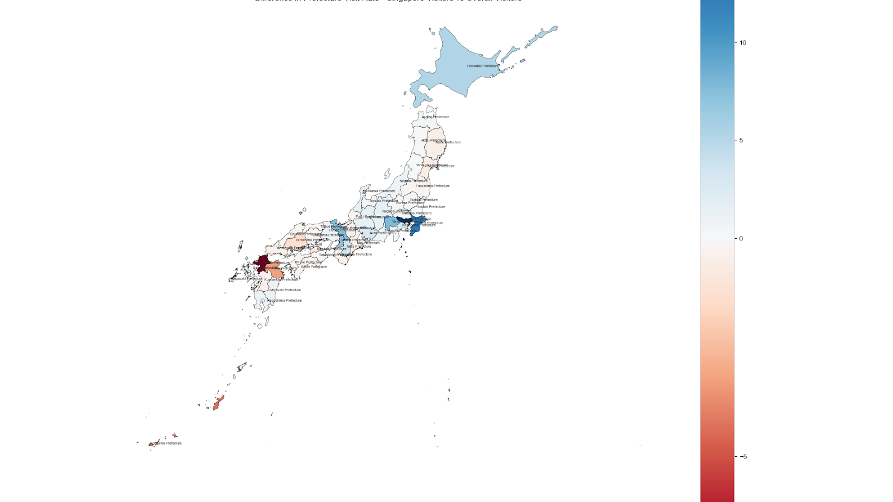
Analysis B2: Prefecture Visit Rate (Singapore vs Overall)
There is a greater proportion of Singapore tourists that choose to visit Tokyo, Chiba, Yamanashi, Kyoto, Osaka and Hokkaido.
Fukuoka, Okinawa, Oita and Hiroshima prefectures are not as much visited by Singaporean tourists.

Slide 9
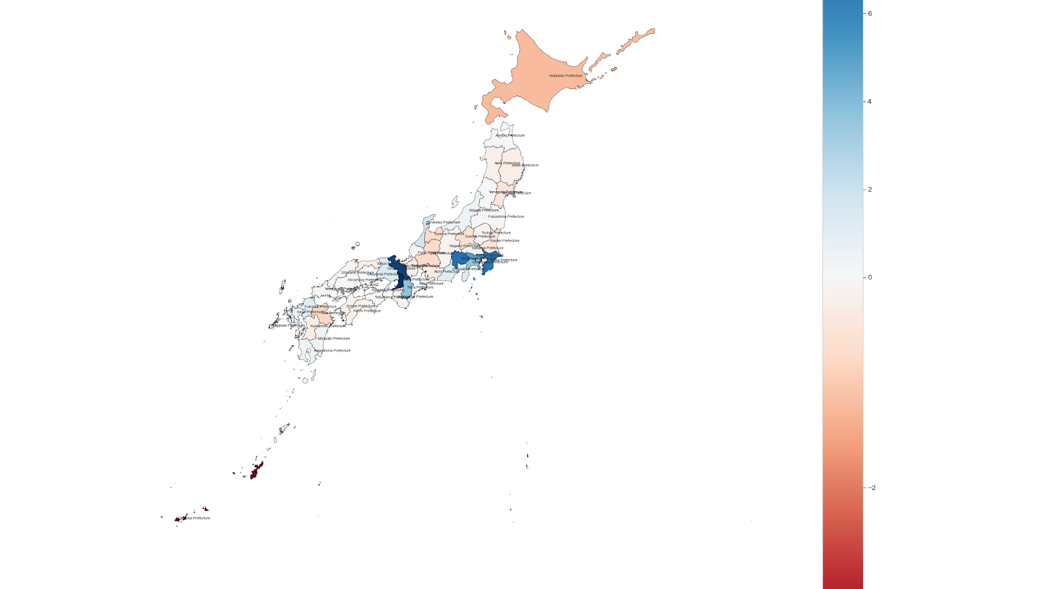
Analysis B3: Singapore Tourists Prefecture Visit Rate (2018 vs 2023)
Okinawa, Hokkaido, Oita saw the biggest drops in Prefecture Visit Rates.
The prefectures that saw the largest increase in Prefecture Visit Rates are Osaka, Kyoto, Yamanashi, Chiba, which mostly happens to be along Japan’s Golden Route.

Slide 10
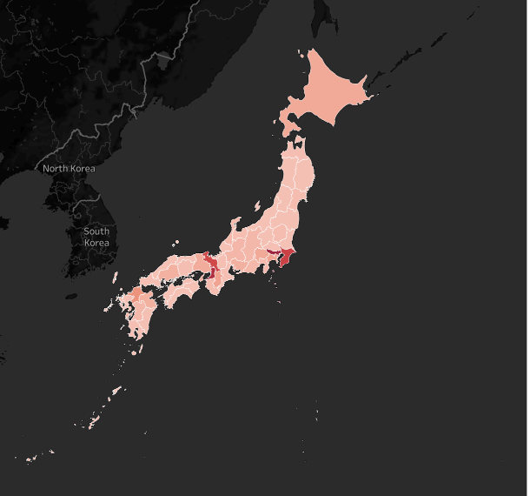
Analysis B4: Prefecture Visit Rate presented in Tableau

